Slide 1
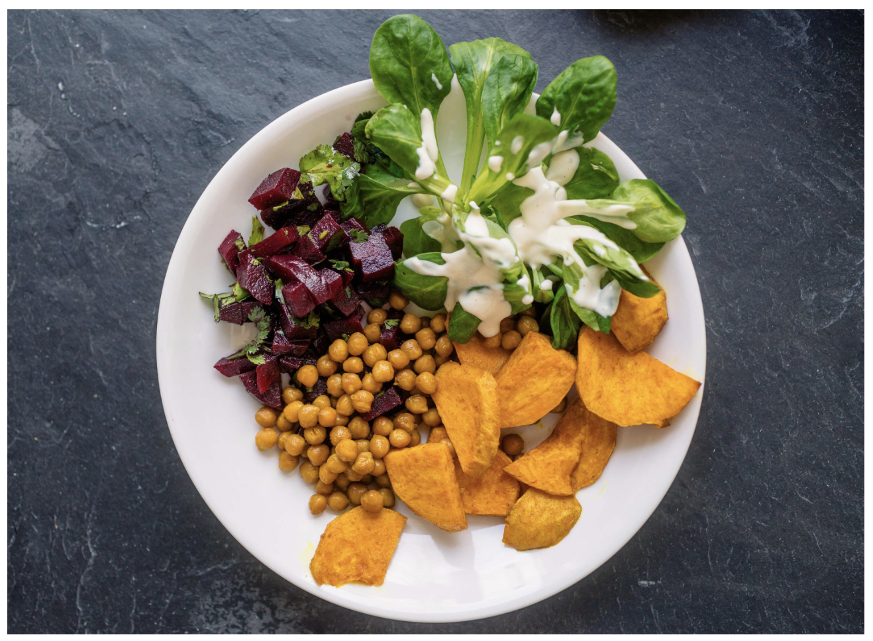
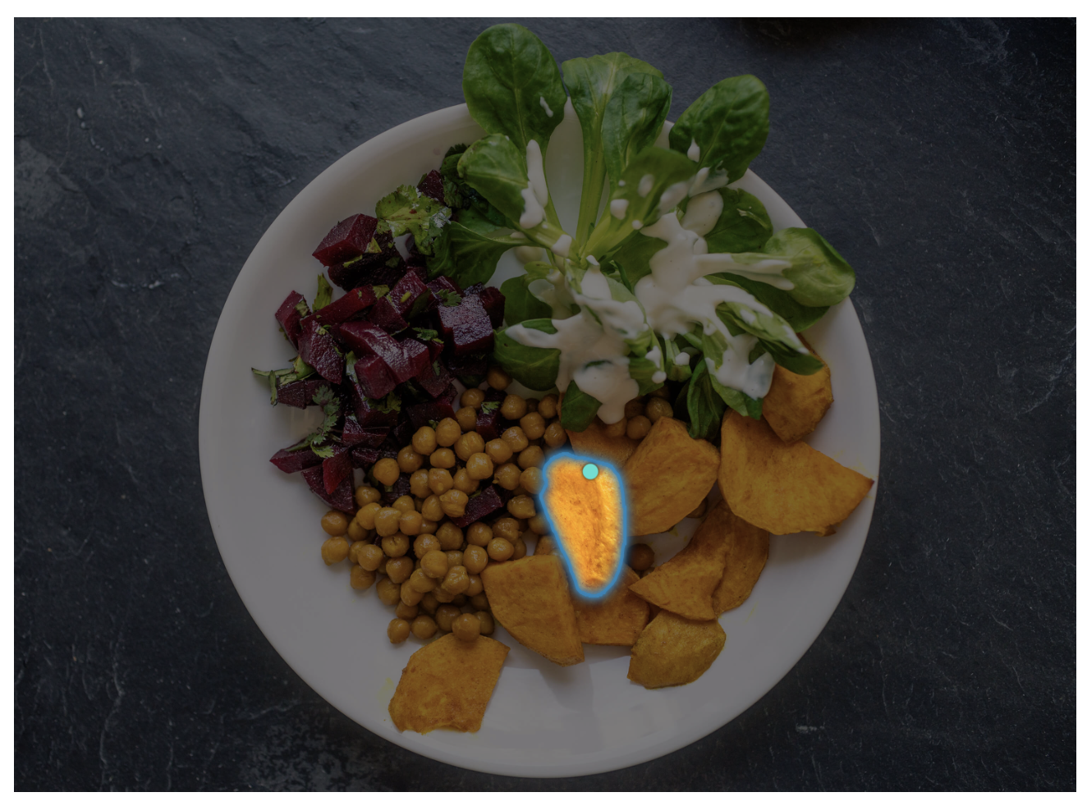
Project Title
Team Name
Sonit Singh (zxxxxxxx)
Hugh Wilson(zxxxxxxx)
Stefano Mezza (zxxxxxxx)
Jingying Gao (zxxxxxxx)
Zhongsui Guo (zxxxxxxx)

Slide 2
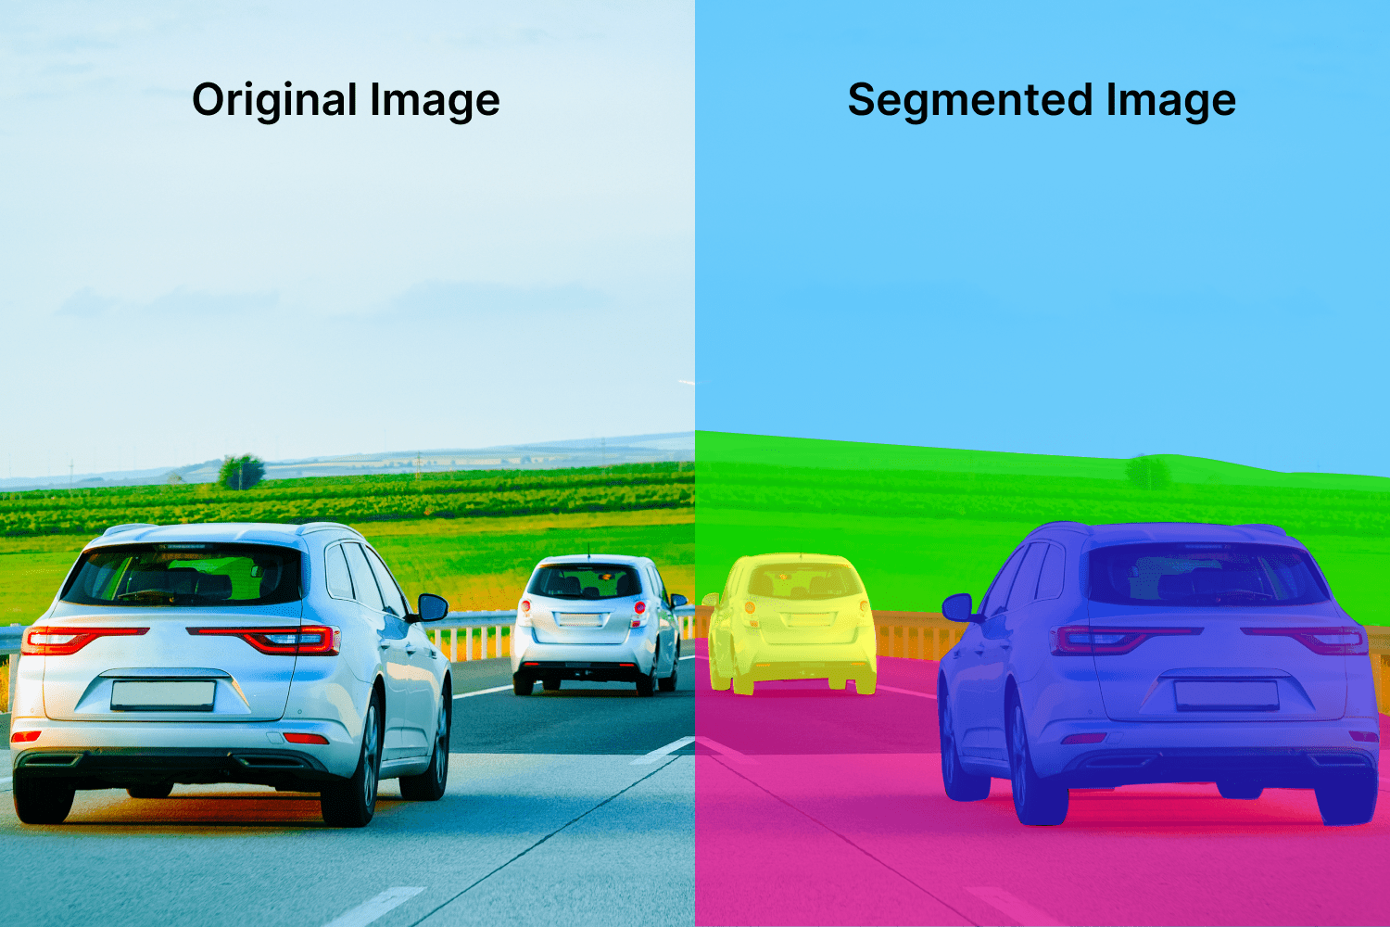
Motivation
This is just an example, please change images and content as per the project. Also, change Presenter’s name and zID for the final project presentation
Image Segmentation: Identifying which image pixels belong to an object
One of the core tasks in computer vision
Broad array of applications:
Medical Image Analysis
Scientific imagery
Editing photos
Autonomous Vehicles
Robotics
Agriculture
…
Presenter: Sonit Singh (zxxxxxxx)

Slide 3
Problem Statement
Write here
Presenter: Hugh Wilson (zxxxxxxx)

Slide 4
Literature Review
Just provide summary in 2 slides of relevant papers
Presenter: Hugh Wilson (zxxxxxxx)

Slide 5
Dataset(s)
Provide details about the dataset or the RL tasks
Presenter: Hugh Wilson (zxxxxxxx)

Slide 6
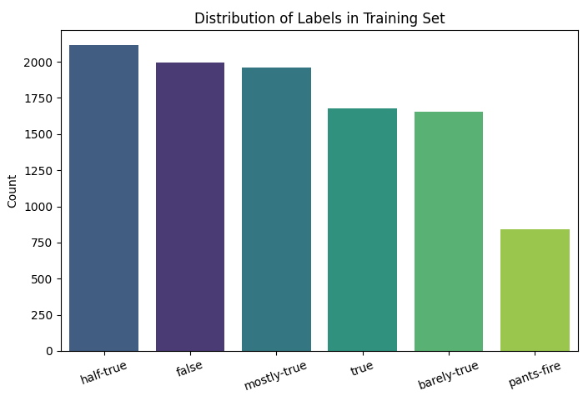
Data Analysis - LIAR Dataset
Data Format
TSV files containing political statements
12,836 samples, 6 classes
Sample distribution of categories
False: 2,638
Half-True: 2,636
Mostly-True: 2,063
True: 2,165
Barely-True: 2,276
Pants-Fire: 1,050
The category distribution is relatively balanced,
but the "Pants-Fire" category is relatively small, with only 1,050 entries.
Data diversity
Diverse topics: covering politics, economy, technology, health and other fields.
Diverse spokespersons: including government officials, experts, public figures, and ordinary people.
Diverse text length: from short sentences to complete statements.
Most news texts are between 10 and 50 words long.
Very few news texts are less than 5 words or more than 100 words.
Stop word problem: some texts contain a lot of meaningless words such as "the", "a", "of", etc.
Physical features
All text data
Mostly short texts (10-50 words on average)
Speakers from different topics, sources, and political backgrounds
Presenter: Zhongsui Guo (zxxxxxxx)

Slide 7
Method(s)
Details here …
Presenter: Zhongsui Guo (zxxxxxxx)

Slide 8
Results
Details here …
Presenter: Zhongsui Guo (zxxxxxxx)

Slide 9
Discussion
Details here …
Presenter: Zhongsui Guo (zxxxxxxx)

Slide 10
Conclusion
Write here
Presenter: Zhongsui Guo (zxxxxxxx)

Slide 11

This Photo by Unknown Author is licensed under CC BY-SA

